Slide 1
Introduction to Autoencoders and Transformers Work Group PDE + AI CEREMADE
29/02/2024

Slide 2
Agenda
Autoencoders (AE)
Variational Autoencoders (VAE)
Recurrent Neural Networks (RNNs)
Transformers
Autoencoder code example (if time…)

Slide 3
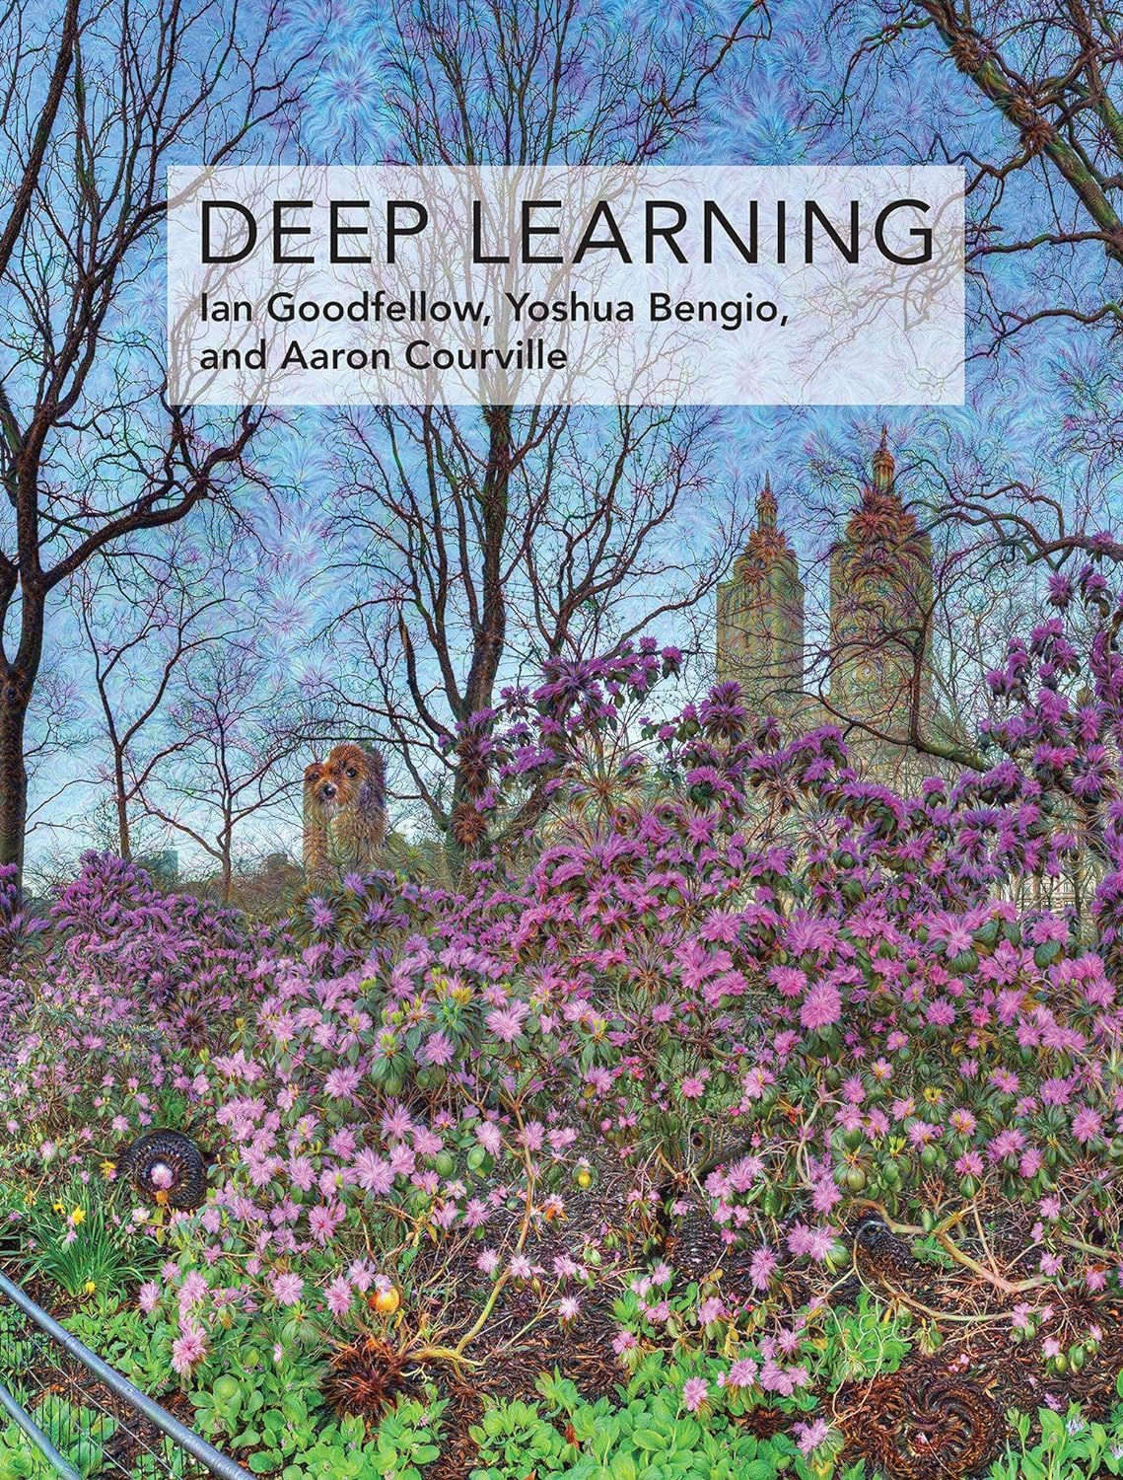
A Major Reference
The Deep Learning textbook [1]
Available online for free: https://www.deeplearningbook.org/
From 2016, but…
Great for concepts
Evolution of the domain
Start Point

Slide 4
Autoencoders (AE)

Slide 5
History
Autoencoders (AE)
Deep Autoencoder [6]
2006
ImageNet Moment [10]
2012
Backpropagation [2]
1986
Denoising Autoencoders [8]
2008
Generative Adversarial
Networks [12]
2014
Sparse Autoencoders [7]
2007
Variational Autoencoders [11]
2013
Stable Diffusion [13]
2021
Auto-associative
Neural Networks
[3, 4, 5]
1987 – 1991
Contractive Autoencoders [9]
2011
Notes:
Give an idea of autoencoders in time
Idea come from beginning of NNs
Deep Autoencoder as we know today from 2006
Lot of work after trying to shape the loss function
Variational Autoencoders from 2013 just before GANs
Culminating in Stable Diffusion from 2021

Slide 6
Concept and Usage
Autoencoders (AE)
Encoder
Decoder
$$X$$
$$f(X)$$
$$g\left(f\left(X\right)\right)=\hat{X}$$
$L\left(X, g\left(f\left(X\right)\right)\right)$
Dimensionality Reduction
Compression
Information Retrieval
Denoising
Anomaly Detection / Segmentation
Notes:
Any architecture that have an encoder and a decoder parts
Objective is to reconstruct the input, but not exactly -> we can enforce properties when encoding or decoding
For example, train the network and after use only the encoder as a dimensionality reduction technique or to compress the input, which could be use for information Retrieval (as a hash table)
Train the network with noisy input to remove the noise
Train the network with labels to detect anomalies/classify or segment images

Slide 7
Type of Autoencoders
Autoencoder (AE)
Undercomplete Autoencoders
$f(X)$ constrained to a have a smaller dimension than $X$
$L\left(X, g\left(f\left(X\right)\right)\right)$ is a measure of dissimilarity (E.g., MSE)
A linear autoencoder learns to span the same subspace as PCA [1]
Regularized Autoencoders (including Overcomplete)
Induce properties via the loss function $L\left(X, g\left(f\left(X\right)\right)\right)$
Sparsity, robustness to noise or missing inputs, smallness of the derivative…
E.g.:
$L\left(X, g\left(f\left(X\right)\right)\right)+Ω\left(f\left(X\right)\right)$, where Ω is L1 regularization (Sparse Autoencoder), penalization over the derivative of the encoder with respect to the input (Contractive Autoencoder)
$L\left(X, g\left(f\left(\tilde{X}\right)\right)\right)$, where $\tilde{X}$ is a corrupted sample (Denoising Autoencoder)
Notes:
Essentially two types od autoencoders: undercomplete and regularized
Undercomplete autoencoders are the most common variant, when the encoded input is constrained to have a smaller dimension than the input itself
The dimensionality reduction already act as a kind of regularization
The loss function can be any measure of dissimilarity, as MSE
We can show that a linear autoencoder learns to span the same subspace as PCA
Regularized autoencoders are any autoencoder that directly apply some kind of regularization, they can be undercomplete or overcomplete
We will induce some desired property via the loss function, usually adding some term that will act as a regularization
For example, inducing sparsity, robustness to noise or missing data, smallness of the derivative
We can for example add a L1 regularization term to obtain a Sparse autoencoder or add a penalization term that depends on the derivative of the encoder with respect to the input to obtain a Contractive AE
We can also use some kind of corruption on the input to learn how to obtain the original input

Slide 8
Variational Autoencoders [11, 14] (VAE)

Slide 9
Idea
Variational Autoencoders (VAE)
Probabilistic generative model
Generator
Random Image ($X$)
$$p_{θ}\left(x\right)=\int{p_{θ}\left(x,z\right)dz}$$
We want to perform the maximization of the likelihood*, but $p_{θ}\left(x\right)$ is intractable: the Inference Problem in the variational Bayesian Approach
Latent Space ($Z$)
Notes:
We want to learn a probability distribution over some Latent space Z, where we can sample to generate new random inputs (images for example)
We will not anymore be interested on point estimations, but on distributions
We will use our data to learn this probability distribution: using a NN, we want to find the parameters that maximizes the likelihood that the distribution p could have generated our images
The problem is that the distribution p is intractable to calculate, because the latent space is high-dimensional (the inference problem in the Variational Bayesian Approach)

Slide 10
The Variational Autoencoder
Variational Autoencoder (VAE)
Z
Decoder
Sampling
$$X$$
$$p_{θ}(z)$$
(imposed)
prior
$$p_{θ}(x|z)$$
likelihood
x: Given data (image)
z: Latent (random) variable

Slide 11
The Variational Autoencoder
Variational Autoencoder (VAE)
Encoder
Z
Decoder
Sampling
$$X$$
$$X$$
$$p_{θ}\left(z|x\right)$$
posterior
$$p_{θ}(z)$$
(imposed)
prior
$$p_{θ}(x|z)$$
likelihood
x: Given data (image)
z: Latent (random) variable

Slide 12
The Variational Autoencoder
Variational Autoencoder (VAE)
Encoder
Z
Decoder
Sampling
$$X$$
$$X$$
$$q_{∅}(z|x)$$
posterior
$$p_{θ}(z)$$
(imposed)
prior
$$p_{θ}(x|z)$$
likelihood
x: Given data (image)
z: Latent (random) variable

Slide 13
The Kullback-Leibler Divergence ($D_{KL}$)
Variational Autoencoders (VAE)
$$D_{KL}\left(p ||q\right)=\int{p(x)\log{\frac{p(x)}{q(x)}dx} }$$
Measure of dissimilarity between two distributions
$D_{KL}\left(p ||q\right)≥0$
$D_{KL}\left(p ||q\right)=0↔p=q almost everywhere$
$D_{KL}\left(p ||q\right)≠D_{KL}\left(q ||p\right)$
Notes:
To be able to solve the problem we will introduce the Kullback-Leibler Divergence
It is a measure if the dissimilarity between 2 distrib,
It is always greater than 0
It will be equal to 0 if and only if both distributions are equal almost everywhere
It is not symmetric

Slide 14
The Evidence of Lower Bound
Variational Autoencoders (VAE)
$p_{θ}\left(z|x\right)≈q_{∅}\left(z|x\right)$ $\log{p_{θ}\left(x\right)}=E_{q_{∅}(z|x)}\left[\log{p_{θ}\left(x\right)}\right]$ $=E_{q_{∅}(z|x)}\left[\log{\frac{p_{θ}\left(x,z\right)}{p_{θ}\left(x|z\right)}}\right]$ $=E_{q_{∅}(z|x)}\left[\log{\frac{p_{θ}\left(x,z\right)}{q_{∅}(z|x)}\frac{q_{∅}(z|x)}{p_{θ}\left(x|z\right)}}\right]$ $=E_{q_{∅}(z|x)}\left[\log{\frac{p_{θ}\left(x,z\right)}{q_{∅}(z|x)}}\right]+E_{q_{∅}(z|x)}\left[\log{\frac{q_{∅}(z|x)}{p_{θ}\left(x|z\right)}}\right]$ $=ELBO+D_{KL}\left(q_{∅}(z|x)||p_{θ}\left(z | x\right)\right)$
$D_{KL}$: Kullback-Leibler Divergence
ELBO: Evidence of Lower Bound
Notes:
1 Chain run of proba. P(A e B) = P(B dado A).P(A)
2 Introduction of inference model q
Split the terms

Slide 15
Interpretation of ELBO
Variational Autoencoders (VAE)
$ELBO=\log{p_{θ}\left(x\right)}−D_{KL}\left(q_{∅}(z|x)||p_{θ}\left(z | x\right)\right)≤\log{p_{θ}\left(x\right)}$
Lower bound on the log-likelihood of the data
Tightness of the bound
Maximization:
Maximize log-likelihood
Minimize KL divergence
$$ELBO=E_{q_{∅}(z|x)}\left[\log{\frac{p_{θ}\left(x,z\right)}{q_{∅}(z|x)}}\right] \\ =E_{q_{∅}(z|x)}\left[\log{\frac{p_{θ}\left(x|z\right)p_{θ}\left(z\right)}{q_{∅}(z|x)}}\right] \\ =E_{q_{∅}(z|x)}\left[\log{p_{θ}\left(x|z\right)}\right]+E_{q_{∅}(z|x)}\left[\log{\frac{p_{θ}\left(z\right)}{q_{∅}(z|x)}}\right] \\ =E_{q_{∅}(z|x)}\left[\log{p_{θ}\left(x|z\right)}\right]−D_{KL}\left(q_{∅}(z|x)||p_{θ}(z)\right)$$
$$Reconstruction Error$$
$$Enforce Prior Distribution$$
Notes:
Bayes theorem P(A dado B) = P(B dado A).P(A)/P(B)

Slide 16
The Reparameterization Trick
Variational Autoencoder (VAE)
Encoder
Z
Decoder
Sampling
$$X$$
$$X$$
$$q_{∅}(z|x)$$
posterior
$$p_{θ}(z)$$
(imposed)
prior
$$p_{θ}(x|z)$$
likelihood
x: Given data (image)
z: Latent (random) variable

Slide 17
The Reparameterization Trick
Variational Autoencoder (VAE)
μ
$$z=μ+σε$$
Encoder
Z
Decoder
$$X$$
$$X$$
σ
$$q_{∅}(z|x)$$
posterior
$$p_{θ}(x|z)$$
likelihood
Sampling
ε
x: Given data (image)
z: Latent (random) variable
$$ε\sim N(0, I)$$
$μ$: Mean of Gaussian Distribution
σ: Covariance Matrix of Gaussian Distribution

Slide 18
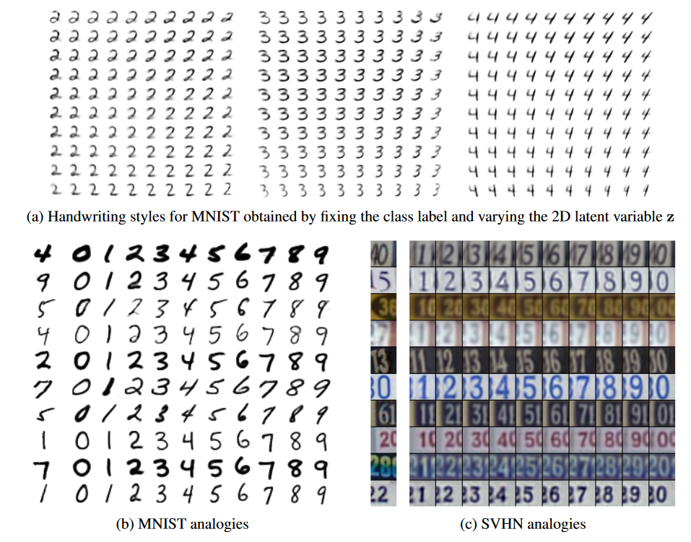
Some Results [11]
Variational Autoencoder (VAE)
Figure 1: (a) Visualization of handwriting styles learned by the model with 2D z-space. (b, c) Analogical reasoning with generative semi-supervised models using a high-dimensional z-space. The leftmost columns show images from the test set. The other columns show analogical fantasies of x by the generative model, where the latent variable z of each row is set to the value inferred from the test-set image on the left by the inference network. Each column corresponds to a class label y.

Slide 19
Recurrent Neural Networks (RNNs)

Slide 20
History of RNNs + Transformers
Recurrent Neural Networks (RNNs)
Attention is All You Need
Transformer Architecture
[19]
2017
Sequence
To
Sequence [16, 17]
2014
Deep Autoencoder [5]
2006
Backpropagation,
Recurrent Net [1]
1986
BERT [21]
2019
ImageNet Moment [9]
2012
LSTM [15]
1997
Attention [18]
2015
GPT [20]
2018
ChatGPT
2022

Slide 21
Recurrent Neural Network (RNN)
Recurrent Neural Networks (RNNs)
$X$: $(X_{0},X_{1},X_{2},…)$
W₁
W₂
$Y$: $(Y_{0},Y_{1},Y_{2},…)$
$$X$$
$$\hat{Y}$$
W₃

Slide 22
Recurrent Neural Network (RNN)
Recurrent Neural Networks (RNNs)
$$\hat{Y_{t−1}}$$
$$\hat{Y_{t}}$$
$$\hat{Y_{t+1}}$$
W₃
W₃
W₃
W₂
W₂
W₂
W₁
W₁
W₁
$$X_{t−1}$$
$$X_{t}$$
$$X_{t+1}$$

Slide 23
Advantages / Drawbacks
Recurrent Neural Networks (RNNs)
Advantages
Drawbacks
Input / Output of variable length
Shared weights
Historical information
Slow computation
Difficult to handle long term dependencies (partially addressed by LSTMs)
Exploding / Vanishing gradient (partially addressed by gradient clipping / skip connections)

Slide 24
Transformers

Slide 25
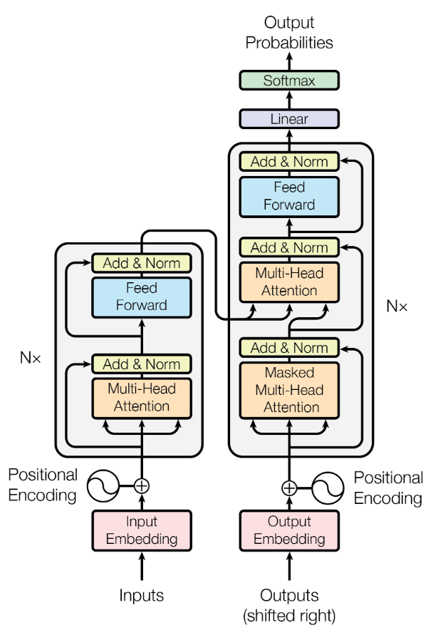
Attention is All You Need [19]
Transformers
Originally applied to translation
Components
Embedding Layer
Positional Encoding
Layer Normalization
Skip Connections
(Masked) Multi-head (Self-) Attention Mechanism

Slide 26
Embedding
Transformers
Word₀
Word₁
Word₂
.
.
.
Word_{n}
Token₀
Token₁
Token₂
.
.
.
Token_{m}
X₀
X₁
X₂
.
.
.
X_{m}
Tokenization
(Word to Numbers)
Embedding
(Lookup Table)
Token # | w₀ | w₁ | … | w_{d}
0 | w₀₀ | w₀₁ | … | w_{0n}
1 | w₁₀ | w₁₁ | … | w_{1n}
. | … | … | … | …
. | … | … | … | …
. | … | … | … | …
k | w_{1k} | w₁₁ | … | w_{1n}
n: Number of Words
m: Number of Tokens
k: Vocabulary Size
d: Embedding Dimension

Slide 27
Positional Encoding
Transformers
Position / Dimension | i=0 0 | i=0 1 | i=1 2 | i=1 3
0 | $$\sin\left(\frac{0}{{1000}^{\frac{0}{4}}}\right)$$ | $$\cos\left(\frac{0}{{1000}^{\frac{0}{4}}}\right)$$ | $$\sin\left(\frac{0}{{1000}^{\frac{1}{4}}}\right)$$ | $$\cos\left(\frac{0}{{1000}^{\frac{1}{4}}}\right)$$
1 | $$\sin\left(\frac{1}{{1000}^{\frac{0}{4}}}\right)$$ | $$\cos\left(\frac{1}{{1000}^{\frac{0}{4}}}\right)$$ | $$\sin\left(\frac{1}{{1000}^{\frac{1}{4}}}\right)$$ | $$\cos\left(\frac{1}{{1000}^{\frac{1}{4}}}\right)$$
. . . | . . . | . . . | . . . | . . .
$PE\left(pos,2i\right)=\sin\left(\frac{pos}{{1000}^{\frac{2i}{d}}}\right)$
$PE\left(pos,2i+1\right)=\cos\left(\frac{pos}{{1000}^{\frac{2i}{d}}}\right)$
E.g.: d=4

Slide 28
Attention Mechanism
Transformers
E.g. Calculate attention value of vectors $X_{0}, X_{1}$ relative to vector $Y_{0}$
$$Similarity Score\left(X,Y\right)=\frac{\sum{x_{i}y_{i}}}{\sqrt{\sum{x_{i}^{2}}}\sqrt{\sum{y_{i}^{2}}}}$$

Slide 29
Attention Mechanism
Transformers
E.g. Calculate attention value of vectors $X_{0}, X_{1}$ relative to vector $Y_{0}$
$$Similarity Score\left(X,Y\right)=\frac{\sum{x_{i}y_{i}}}{\sqrt{\sum{x_{i}^{2}}}\sqrt{\sum{y_{i}^{2}}}}$$

Slide 30
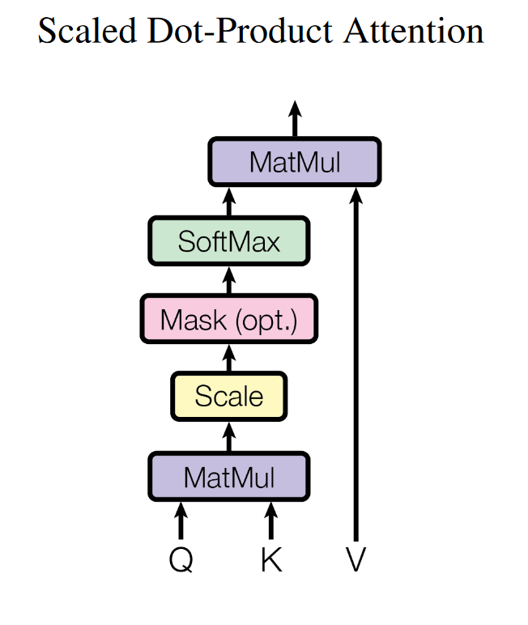
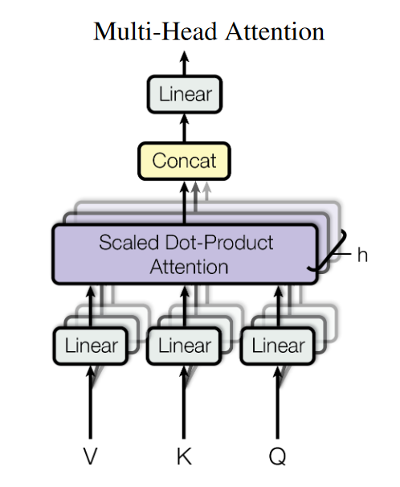
Multi-head Attention
Transformers
$$Attention\left(Q,K,V\right)=\text{softmax}\left(\frac{QK^{T}}{\sqrt{d_{k}}}\right)V$$

Slide 31
Encoding and Decoding
Transformers
X₁
X₂
X₃
.
.
.
X_{n}=<EOS>
Y₀ = <SOS>
Y₁
Y₂
Y₃
.
.
.
Ym=<EOS>
Y₂

Slide 32
Encoding and Decoding
Transformers
X₁
X₂
X₃
.
.
.
X_{n}=<EOS>
Y₀ = <SOS>
Y₁
Y₂
Y₃
.
.
.
Ym=<EOS>
Y₃

Slide 33
Thank You!
Bruno Belucci Teixeira
bruno.belucci-teixeira@dauphine.eu
bruno.belucci-teixeira@bnpparibas.com

Slide 34
Appendix A
Observed data X (random sample from a distribution)
Assuming probability distribution $p$ that depends on unknown parameters θ, which are the parameters that maximizes the likelihood of our observed data?
Assuming i.i.d. samples:
$$L\left(θ|X\right)=P\left(X_{1}=x_{1}, X_{2}=x2,…\right)=p_{θ}\left(x_{1}\right)p_{θ}\left(x_{2}\right)…$$
To maximize $L\left(θ|X\right)$ we need:
$$\frac{∂L\left(θ|X\right)}{∂θ}$$

Slide 35
References
[1] Ian Goodfellow, Yoshua Bengio, and Aaron Courville. Deep Learning. MIT Press, 2016.
[2] David E. Rumelhart, Geoffrey E. Hinton, and Ronald J. Williams. “Learning representations by back-propagating errors”. In: Nature 323.6088 (Oct. 1986). Number: 6088 Publisher: Nature Publishing Group, pp. 533–536. issn: 1476-4687. doi: 10.1038/323533a0. url: https://www.nature.com/articles/323533a0 (visited on 02/20/2024).
[3] Y. Le Cun and Françoise Fogelman-Soulié. “Modèles connexionnistes de l’apprentissage”. In: Intellectica 2.1 (1987). Publisher: Persée - Portail des revues scientifiques en SHS, pp. 114–143. doi: 10.3406/intel.1987.1804. url: https://www.persee.fr/doc/intel_0769-4113_1987_num_2_1_1804 (visited on 02/19/2024).
[4] H. Bourlard and Y. Kamp. “Auto-association by multilayer perceptrons and singular value decomposition”. In: Biological Cybernetics 59.4 (Sept. 1, 1988), pp. 291–294. issn: 1432-0770. doi: 10.1007/BF00332918. url: https://doi.org/10.1007/BF00332918 (visited on 02/19/2024).
[5] Mark A. Kramer. “Nonlinear principal component analysis using autoassociative neural networks”. In: AIChE Journal 37.2 (1991). _eprint: https://onlinelibrary.wiley.com/doi/pdf/10.1002/aic.690370209, pp. 233–243. issn: 1547-5905. doi: 10.1002/aic.690370209. url: https://onlinelibrary.wiley.com/doi/abs/10.1002/aic.690370209 (visited on 02/19/2024).
[6] G. E. Hinton and R. R. Salakhutdinov. “Reducing the Dimensionality of Data with Neural Networks”. In: Science 313.5786 (July 28, 2006). Publisher: American Association for the Advancement of Science, pp. 504–507. doi: 10.1126/science.1127647. url: https://www.science.org/doi/10.1126/science.1127647 (visited on 02/19/2024).
[7] Marc’ aurelio Ranzato et al. “Efficient Learning of Sparse Representations with an Energy-Based Model”. In: Advances in Neural Information Processing Systems. Vol. 19. MIT Press, 2006. url: https://papers.nips.cc/paper_files/paper/2006/hash/87f4d79e36d68c3031ccf6c55e9bbd39-Abstract.html (visited on 02/19/2024).

Slide 36
References
[8] Pascal Vincent et al. “Extracting and composing robust features with denoising autoencoders”. In: Proceedings of the 25th international conference on Machine learning. ICML ’08. New York, NY, USA: Association for Computing Machinery, July 5, 2008, pp. 1096–1103. isbn: 978-1-60558-205-4. doi: 10.1145/1390156.1390294. url: https://doi.org/10.1145/1390156.1390294 (visited on 02/19/2024).
[9] Salah Rifai et al. “Contractive auto-encoders: explicit invariance during feature extraction”. In: Proceedings of the 28th International Conference on International Conference on Machine Learning. ICML’11. Madison, WI, USA: Omnipress, June 28, 2011, pp. 833–840. isbn: 978-1-4503-0619-5. (Visited on 02/19/2024).
[10] Alex Krizhevsky, Ilya Sutskever, and Geoffrey E Hinton. “ImageNet Classification with Deep Convolutional Neural Networks”. In: Advances in Neural Information Processing Systems. Vol. 25. Curran Associates, Inc., 2012. url: https://papers.nips.cc/paper/2012/hash/c399862d3b9d6b76c8436e924a68c45b-Abstract.html (visited on 10/26/2022).
[11] Diederik P. Kingma et al. “Semi-supervised learning with deep generative models”. In: Proceedings of the 27th International Conference on Neural Information Processing Systems - Volume 2. NIPS’14. Cambridge, MA, USA: MIT Press, Dec. 8, 2014, pp. 3581–3589. (Visited on 02/19/2024).
[12] Ian J. Goodfellow et al. Generative Adversarial Networks. June 10, 2014. doi: 10.48550/arXiv.1406.2661. arXiv: 1406.2661 [cs, stat]. url: http://arxiv.org/abs/1406.2661 (visited on 02/21/2024).
[13] Robin Rombach et al. High-Resolution Image Synthesis with Latent Diffusion Models. Apr. 13, 2022. doi: 10.48550/arXiv.2112.10752. arXiv: 2112.10752 [cs]. url: http://arxiv.org/abs/2112.10752 (visited on 02/19/2024).
[14] Diederik P. Kingma and Max Welling. “An Introduction to Variational Autoencoders”. In: Foundations and Trends® in Machine Learning 12.4 (2019), pp. 307–392. issn: 1935-8237, 1935-8245. doi: 10.1561/2200000056. arXiv: 1906.02691 [cs, stat]. url: http://arxiv.org/abs/1906.02691 (visited on 02/20/2024).
[15] Sepp Hochreiter and Jürgen Schmidhuber. “Long Short-Term Memory”. In: Neural Computation 9.8 (Nov. 1, 1997), pp. 1735–1780. issn: 0899-7667. doi: 10.1162/neco.1997.9.8.1735. url: https://doi.org/10.1162/neco.1997.9.8.1735 (visited on 02/20/2024).

Slide 37
References
[16] Ilya Sutskever, Oriol Vinyals, and Quoc V. Le. Sequence to Sequence Learning with Neural Networks. Dec. 14, 2014. doi: 10.48550/arXiv.1409.3215. arXiv: 1409.3215 [cs]. url: http://arxiv.org/abs/1409.3215 (visited on 02/20/2024).
[17] Kyunghyun Cho et al. “Learning Phrase Representations using RNN Encoder–Decoder for Statistical Machine Translation”. In: Proceedings of the 2014 Conference on Empirical Methods in Natural Language Processing (EMNLP). EMNLP 2014. Ed. by Alessandro Moschitti, Bo Pang, and Walter Daelemans. Doha, Qatar: Association for Computational Linguistics, Oct. 2014, pp. 1724–1734. doi: 10.3115/v1/D14-1179. url: https://aclanthology.org/D14-1179 (visited on 02/20/2024).
[18] Dzmitry Bahdanau, Kyunghyun Cho, and Yoshua Bengio. Neural Machine Translation by Jointly Learning to Align and Translate. May 19, 2016. doi: 10.48550/arXiv.1409.0473. arXiv: 1409.0473 [cs, stat]. url: http://arxiv.org/abs/1409.0473 (visited on 02/20/2024).
[19] Ashish Vaswani et al. Attention Is All You Need. Number: arXiv:1706.03762. Dec. 5, 2017. doi: 10.48550/arXiv.1706.03762. arXiv: 1706.03762 [cs]. url: http://arxiv.org/abs/1706.03762 (visited on 06/28/2022).
[20] Alec Radford and Karthik Narasimhan. “Improving Language Understanding by Generative Pre-Training”. In: 2018. url: https://www.semanticscholar.org/paper/Improving-Language-Understanding-by-Generative-Radford-Narasimhan/cd18800a0fe0b668a1cc19f2ec95b5003d0a5035 (visited on 02/20/2024).
[21] Jacob Devlin et al. BERT: Pre-training of Deep Bidirectional Transformers for Language Understanding. May 24, 2019. doi: 10.48550/arXiv.1810.04805. arXiv: 1810.04805 [cs]. url: http://arxiv.org/abs/1810.04805 (visited on 02/20/2024).

